Slide 1
100 Days of Functions

Slide 2
Purpose
100 Days of Functions provides Algebra 1 teachers with a purposeful sequence of functions for students to graph daily. This sequence should lead to several meaningful conversations for students to make sense of graphing, using mathematical vocabulary, and more.
For each graph they construct, students compete to write down as many attributes about that function as they can identify. This analysis allows students and their teacher the opportunity to practice graphing using a function table, have discussions about patterns and structures seen (MTR 5), explore key features of functions (AR.2.4, AR.2.5, AR.3.7, AR.3.8, AR.4.3, AR.5.6, F.1.5, F.1.6), explore function types (F.1.1), and explore transformations of functions (F.2.1).
Students can use a notebook and graph paper to complete the exercises, or teachers can print off the slides to provide for them.

Slide 3
Associated Benchmarks
MA.912.AR.2.4 - Given a table, equation or written description of a linear function, graph that function, and determine and interpret its key features.
MA.912.AR.2.5 - Solve and graph mathematical and real-world problems that are modeled with linear functions. Interpret key features and determine domain constraints in terms of the context.
MA.912.AR.3.7 - Given a table, equation or written description of a quadratic function, graph that function, and determine and interpret its key features.
MA.912.AR.3.8 - Solve and graph mathematical and real-world problems that are modeled with quadratic functions. Interpret key features and determine domain constraints in terms of the context.
MA.912.AR.4.3 - Given a table, equation or written description of an absolute value function, graph that function and determine its key features.
MA.912.AR.5.3 - Given a mathematical or real-world context, classify an exponential function as representing growth or decay.
MA.912.AR.5.6 - Given a table, equation or written description of an exponential function, graph that function and determine its key features.

Slide 4
Associated Benchmarks
MA.912.F.1.1 - Given an equation or graph that defines a function, classify the function type. Given an input-output table, determine a function type that could represent it.
MA.912.F.1.5 - Compare key features of linear functions each represented algebraically, graphically, in tables or written descriptions.
MA.912.F.1.6 - Compare key features of linear and nonlinear functions each represented algebraically, graphically, in tables or written descriptions.
MA.912.F.2.1 - Identify the effect on the graph or table of a given function after replacing 𝑓(𝑥) by 𝑓(𝑥)+𝑘, 𝑘𝑓(𝑥), 𝑓(𝑘𝑥) and 𝑓(𝑥+𝑘), for specific values of 𝑘.

Slide 5
Day 1
On the coordinate plane:
Label the x-axis.
Label the y-axis.
Label the x-axis using a scale of one.
Label the y-axis using a scale of five.
Write the point that has an x-coordinate of 4 and a y-coordinate of 25. ___________ Graph the point on the coordinate plane.

Slide 6
Day 2
Label the x- and y- axes.
Determine a suitable scale of the x-axis to graph the following points:
(12, y) _________
(45, y) _________
(200, y) _________
Label the axes with the appropriate scales and graph the following on the coordinate plane.
A (4, 16)
B (5, 20)
C (12, 2)
D(24, 18)

Slide 7
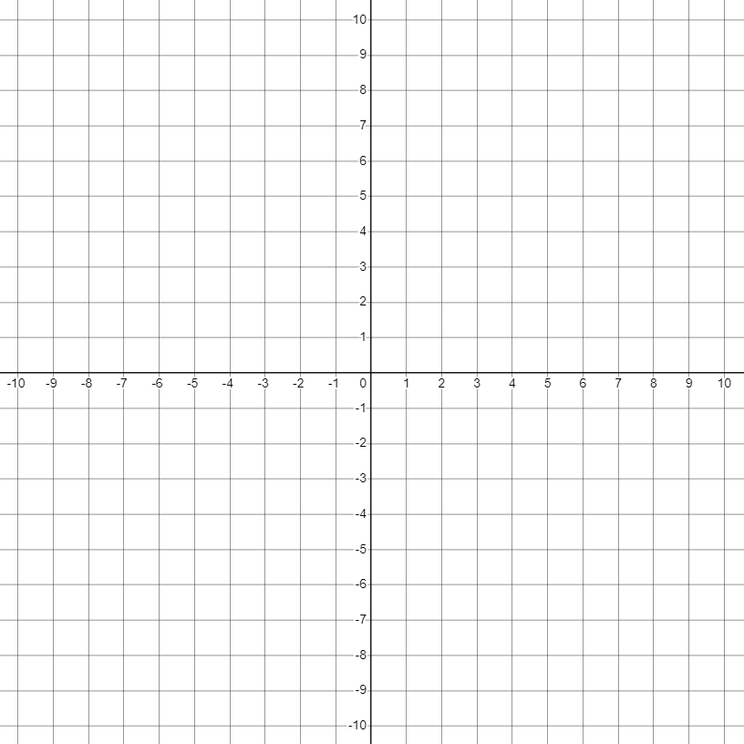
Day 3
$$y=x−6$$
One approach to graphing functions is to use a function table. Function tables record multiple x,y pairs that will substitute into the function to make it true. Completing a function table for a function will give you multiple points to graph on the coordinate grid.
Complete the function table below for the x values provided. The first two rows have been done for you. Once completed, plot the points on the coordinate grid and graph the function.
x | y
-2 | -8
-1 | -7
0
1
2

Slide 8
Day 4
$$y=\frac{1}{3}x−6$$
Use today’s function to complete both function tables below.
Which table is easier to complete? Why?
Plot the points from the first table and graph the function.
Plot the points from the second table. What do you notice?
x | y
-2
-1
0
1
2
x | y
-6
-3
0
3
6

Slide 9
Day 5
Define the domain of a function:
Define the range of a function:
What is the domain and range of the relation: {(-3,2), (4,1), (5,0), (1,-1)}?
D=______________________ R=______________________
Describe the domain and range for each of the lines on the coordinate plane.
Line | Domain | Range
blue line
red line
orange line

Slide 10
Day 6
$$y=x$$
Graph the function and list as many attributes of the function as you can think of.
Observed Attributes
________________________________________
________________________________________
________________________________________
________________________________________
________________________________________
________________________________________
________________________________________
________________________________________
________________________________________
________________________________________
________________________________________
________________________________________
________________________________________
________________________________________
________________________________________

Slide 11
Day 7
$$y=2x$$
Observed Attributes
________________________________________
________________________________________
________________________________________
________________________________________
________________________________________
________________________________________
________________________________________
________________________________________
________________________________________
________________________________________
________________________________________
________________________________________
________________________________________
________________________________________
________________________________________

Slide 12
Day 8
$$y=4x$$
Observed Attributes
________________________________________
________________________________________
________________________________________
________________________________________
________________________________________
________________________________________
________________________________________
________________________________________
________________________________________
________________________________________
________________________________________
________________________________________
________________________________________
________________________________________
________________________________________

Slide 13
Day 9
$$y=8x$$
Observed Attributes
________________________________________
________________________________________
________________________________________
________________________________________
________________________________________
________________________________________
________________________________________
________________________________________
________________________________________
________________________________________
________________________________________
________________________________________
________________________________________
________________________________________
________________________________________

Slide 14
Day 10
$$y=\frac{1}{2}x$$
Observed Attributes
________________________________________
________________________________________
________________________________________
________________________________________
________________________________________
________________________________________
________________________________________
________________________________________
________________________________________
________________________________________
________________________________________
________________________________________
________________________________________
________________________________________
________________________________________

Slide 15
Day 11
$$y=\frac{1}{4}x$$
Observed Attributes
________________________________________
________________________________________
________________________________________
________________________________________
________________________________________
________________________________________
________________________________________
________________________________________
________________________________________
________________________________________
________________________________________
________________________________________
________________________________________
________________________________________
________________________________________

Slide 16
Day 12
$$y=\frac{1}{8}x$$
Observed Attributes
________________________________________
________________________________________
________________________________________
________________________________________
________________________________________
________________________________________
________________________________________
________________________________________
________________________________________
________________________________________
________________________________________
________________________________________
________________________________________
________________________________________
________________________________________

Slide 17
Day 13
$$y=x+3$$
Observed Attributes
________________________________________
________________________________________
________________________________________
________________________________________
________________________________________
________________________________________
________________________________________
________________________________________
________________________________________
________________________________________
________________________________________
________________________________________
________________________________________
________________________________________
________________________________________

Slide 18
Day 14
$$y=x+7$$
Observed Attributes
________________________________________
________________________________________
________________________________________
________________________________________
________________________________________
________________________________________
________________________________________
________________________________________
________________________________________
________________________________________
________________________________________
________________________________________
________________________________________
________________________________________
________________________________________

Slide 19
Day 15
$$y=x−3$$
Observed Attributes
________________________________________
________________________________________
________________________________________
________________________________________
________________________________________
________________________________________
________________________________________
________________________________________
________________________________________
________________________________________
________________________________________
________________________________________
________________________________________
________________________________________
________________________________________

Slide 20
Day 16
$$y=x–7$$
Observed Attributes
________________________________________
________________________________________
________________________________________
________________________________________
________________________________________
________________________________________
________________________________________
________________________________________
________________________________________
________________________________________
________________________________________
________________________________________
________________________________________
________________________________________
________________________________________

Slide 21
Day 17
$$y=2x+3$$
Observed Attributes
________________________________________
________________________________________
________________________________________
________________________________________
________________________________________
________________________________________
________________________________________
________________________________________
________________________________________
________________________________________
________________________________________
________________________________________
________________________________________
________________________________________
________________________________________

Slide 22
Day 18
$$y=4x−7$$
Observed Attributes
________________________________________
________________________________________
________________________________________
________________________________________
________________________________________
________________________________________
________________________________________
________________________________________
________________________________________
________________________________________
________________________________________
________________________________________
________________________________________
________________________________________
________________________________________

Slide 23
Day 19
$$y=\frac{1}{4}x−2$$
Observed Attributes
________________________________________
________________________________________
________________________________________
________________________________________
________________________________________
________________________________________
________________________________________
________________________________________
________________________________________
________________________________________
________________________________________
________________________________________
________________________________________
________________________________________
________________________________________

Slide 24
Day 20
$$y=−x$$
Observed Attributes
________________________________________
________________________________________
________________________________________
________________________________________
________________________________________
________________________________________
________________________________________
________________________________________
________________________________________
________________________________________
________________________________________
________________________________________
________________________________________
________________________________________
________________________________________

Slide 25
Day 21
$$y=−2x$$
Observed Attributes
________________________________________
________________________________________
________________________________________
________________________________________
________________________________________
________________________________________
________________________________________
________________________________________
________________________________________
________________________________________
________________________________________
________________________________________
________________________________________
________________________________________
________________________________________

Slide 26
Day 22
$$y=−4x$$
Observed Attributes
________________________________________
________________________________________
________________________________________
________________________________________
________________________________________
________________________________________
________________________________________
________________________________________
________________________________________
________________________________________
________________________________________
________________________________________
________________________________________
________________________________________
________________________________________

Slide 27
Day 23
$$y=−8x$$
Observed Attributes
________________________________________
________________________________________
________________________________________
________________________________________
________________________________________
________________________________________
________________________________________
________________________________________
________________________________________
________________________________________
________________________________________
________________________________________
________________________________________
________________________________________
________________________________________

Slide 28
Day 24
$$y=−\frac{1}{2}x$$
Observed Attributes
________________________________________
________________________________________
________________________________________
________________________________________
________________________________________
________________________________________
________________________________________
________________________________________
________________________________________
________________________________________
________________________________________
________________________________________
________________________________________
________________________________________
________________________________________

Slide 29
Day 25
$$y=−\frac{1}{4}x$$
Observed Attributes
________________________________________
________________________________________
________________________________________
________________________________________
________________________________________
________________________________________
________________________________________
________________________________________
________________________________________
________________________________________
________________________________________
________________________________________
________________________________________
________________________________________
________________________________________

Slide 30
Day 26
$$y=−\frac{1}{8}x$$
Observed Attributes
________________________________________
________________________________________
________________________________________
________________________________________
________________________________________
________________________________________
________________________________________
________________________________________
________________________________________
________________________________________
________________________________________
________________________________________
________________________________________
________________________________________
________________________________________

Slide 31
Day 27
$$y=−x+3$$
Observed Attributes
________________________________________
________________________________________
________________________________________
________________________________________
________________________________________
________________________________________
________________________________________
________________________________________
________________________________________
________________________________________
________________________________________
________________________________________
________________________________________
________________________________________
________________________________________

Slide 32
Day 28
$$y=−x–7$$
Observed Attributes
________________________________________
________________________________________
________________________________________
________________________________________
________________________________________
________________________________________
________________________________________
________________________________________
________________________________________
________________________________________
________________________________________
________________________________________
________________________________________
________________________________________
________________________________________

Slide 33
Day 29
$$y=−2x+3$$
Observed Attributes
________________________________________
________________________________________
________________________________________
________________________________________
________________________________________
________________________________________
________________________________________
________________________________________
________________________________________
________________________________________
________________________________________
________________________________________
________________________________________
________________________________________
________________________________________

Slide 34
Day 30
$$y=−4x−7$$
Observed Attributes
________________________________________
________________________________________
________________________________________
________________________________________
________________________________________
________________________________________
________________________________________
________________________________________
________________________________________
________________________________________
________________________________________
________________________________________
________________________________________
________________________________________
________________________________________

Slide 35
Day 31
$$y=−\frac{1}{4}x−2$$
Observed Attributes
________________________________________
________________________________________
________________________________________
________________________________________
________________________________________
________________________________________
________________________________________
________________________________________
________________________________________
________________________________________
________________________________________
________________________________________
________________________________________
________________________________________
________________________________________

Slide 36
Day 32
$$y=−5x+10$$
Observed Attributes
________________________________________
________________________________________
________________________________________
________________________________________
________________________________________
________________________________________
________________________________________
________________________________________
________________________________________
________________________________________
________________________________________
________________________________________
________________________________________
________________________________________
________________________________________

Slide 37
Day 33
$$5x+y=10$$
Observed Attributes
________________________________________
________________________________________
________________________________________
________________________________________
________________________________________
________________________________________
________________________________________
________________________________________
________________________________________
________________________________________
________________________________________
________________________________________
________________________________________
________________________________________
________________________________________

Slide 38
Day 34
$$y=2x−4$$
Observed Attributes
________________________________________
________________________________________
________________________________________
________________________________________
________________________________________
________________________________________
________________________________________
________________________________________
________________________________________
________________________________________
________________________________________
________________________________________
________________________________________
________________________________________
________________________________________

Slide 39
Day 35
$$8x−4y=16$$
Observed Attributes
________________________________________
________________________________________
________________________________________
________________________________________
________________________________________
________________________________________
________________________________________
________________________________________
________________________________________
________________________________________
________________________________________
________________________________________
________________________________________
________________________________________
________________________________________

Slide 40
Day 36
$$3x+6y=−18$$
Observed Attributes
________________________________________
________________________________________
________________________________________
________________________________________
________________________________________
________________________________________
________________________________________
________________________________________
________________________________________
________________________________________
________________________________________
________________________________________
________________________________________
________________________________________
________________________________________

Slide 41
Day 37
$$7x−14y=−56$$
Observed Attributes
________________________________________
________________________________________
________________________________________
________________________________________
________________________________________
________________________________________
________________________________________
________________________________________
________________________________________
________________________________________
________________________________________
________________________________________
________________________________________
________________________________________
________________________________________

Slide 42
Day 38
$$x=−5$$
Observed Attributes
________________________________________
________________________________________
________________________________________
________________________________________
________________________________________
________________________________________
________________________________________
________________________________________
________________________________________
________________________________________
________________________________________
________________________________________
________________________________________
________________________________________
________________________________________

Slide 43
Day 39
$$y=8$$
Observed Attributes
________________________________________
________________________________________
________________________________________
________________________________________
________________________________________
________________________________________
________________________________________
________________________________________
________________________________________
________________________________________
________________________________________
________________________________________
________________________________________
________________________________________
________________________________________

Slide 44
Day 40
$$y=\frac{1}{2}x+1$$
Observed Attributes
________________________________________
________________________________________
________________________________________
________________________________________
________________________________________
________________________________________
________________________________________
________________________________________
________________________________________
________________________________________
________________________________________
________________________________________
________________________________________
________________________________________
________________________________________

Slide 45
Day 41
$$y+2=\frac{1}{2}(x+6)$$
Observed Attributes
________________________________________
________________________________________
________________________________________
________________________________________
________________________________________
________________________________________
________________________________________
________________________________________
________________________________________
________________________________________
________________________________________
________________________________________
________________________________________
________________________________________
________________________________________

Slide 46
Day 42
$$y+1=\frac{1}{2}(x+4)$$
Observed Attributes
________________________________________
________________________________________
________________________________________
________________________________________
________________________________________
________________________________________
________________________________________
________________________________________
________________________________________
________________________________________
________________________________________
________________________________________
________________________________________
________________________________________
________________________________________

Slide 47
Day 43
$$y−2=\frac{1}{2}(x−2)$$
Observed Attributes
________________________________________
________________________________________
________________________________________
________________________________________
________________________________________
________________________________________
________________________________________
________________________________________
________________________________________
________________________________________
________________________________________
________________________________________
________________________________________
________________________________________
________________________________________

Slide 48
Day 44
$$y+7=−3(x−9)$$
Observed Attributes
________________________________________
________________________________________
________________________________________
________________________________________
________________________________________
________________________________________
________________________________________
________________________________________
________________________________________
________________________________________
________________________________________
________________________________________
________________________________________
________________________________________
________________________________________

Slide 49
Day 45
$$y+1=−(x+1)$$
Observed Attributes
________________________________________
________________________________________
________________________________________
________________________________________
________________________________________
________________________________________
________________________________________
________________________________________
________________________________________
________________________________________
________________________________________
________________________________________
________________________________________
________________________________________
________________________________________

Slide 50
Day 46
$$y=−2x−7$$
Observed Attributes
________________________________________
________________________________________
________________________________________
________________________________________
________________________________________
________________________________________
________________________________________
________________________________________
________________________________________
________________________________________
________________________________________
________________________________________
________________________________________
________________________________________
________________________________________

Slide 51
Day 47
$$y−5=−2(x+6)$$
Observed Attributes
________________________________________
________________________________________
________________________________________
________________________________________
________________________________________
________________________________________
________________________________________
________________________________________
________________________________________
________________________________________
________________________________________
________________________________________
________________________________________
________________________________________
________________________________________

Slide 52
Day 48
$$2x+y=−7$$
Observed Attributes
________________________________________
________________________________________
________________________________________
________________________________________
________________________________________
________________________________________
________________________________________
________________________________________
________________________________________
________________________________________
________________________________________
________________________________________
________________________________________
________________________________________
________________________________________

Slide 53
Day 49
$$y=2x−4$$
$$y=2x+1$$
Observed Attributes
________________________________________
________________________________________
________________________________________
________________________________________
________________________________________
________________________________________
________________________________________
________________________________________
________________________________________
________________________________________
________________________________________
________________________________________
________________________________________
________________________________________
________________________________________

Slide 54
Day 50
$$y=2x−4$$
$$y=−\frac{1}{2}x+1$$
Observed Attributes
________________________________________
________________________________________
________________________________________
________________________________________
________________________________________
________________________________________
________________________________________
________________________________________
________________________________________
________________________________________
________________________________________
________________________________________
________________________________________
________________________________________
________________________________________

Slide 55
Day 51
$$y=2x−4$$
$$8x−4y=16$$
Observed Attributes
________________________________________
________________________________________
________________________________________
________________________________________
________________________________________
________________________________________
________________________________________
________________________________________
________________________________________
________________________________________
________________________________________
________________________________________
________________________________________
________________________________________
________________________________________

Slide 56
Day 52
$$y=x^{2}$$
Observed Attributes
________________________________________
________________________________________
________________________________________
________________________________________
________________________________________
________________________________________
________________________________________
________________________________________
________________________________________
________________________________________
________________________________________
________________________________________
________________________________________
________________________________________
________________________________________

Slide 57
Day 53
$$y={−x}^{2}$$
Observed Attributes
________________________________________
________________________________________
________________________________________
________________________________________
________________________________________
________________________________________
________________________________________
________________________________________
________________________________________
________________________________________
________________________________________
________________________________________
________________________________________
________________________________________
________________________________________

Slide 58
Day 54
$$y={2x}^{2}$$
Observed Attributes
________________________________________
________________________________________
________________________________________
________________________________________
________________________________________
________________________________________
________________________________________
________________________________________
________________________________________
________________________________________
________________________________________
________________________________________
________________________________________
________________________________________
________________________________________

Slide 59
Day 55
$$y={−3x}^{2}$$
Observed Attributes
________________________________________
________________________________________
________________________________________
________________________________________
________________________________________
________________________________________
________________________________________
________________________________________
________________________________________
________________________________________
________________________________________
________________________________________
________________________________________
________________________________________
________________________________________

Slide 60
Day 56
$$y={3x}^{2}−5$$
Observed Attributes
________________________________________
________________________________________
________________________________________
________________________________________
________________________________________
________________________________________
________________________________________
________________________________________
________________________________________
________________________________________
________________________________________
________________________________________
________________________________________
________________________________________
________________________________________

Slide 61
Day 57
$$y={−2x}^{2}+9$$
Observed Attributes
________________________________________
________________________________________
________________________________________
________________________________________
________________________________________
________________________________________
________________________________________
________________________________________
________________________________________
________________________________________
________________________________________
________________________________________
________________________________________
________________________________________
________________________________________

Slide 62
Day 58
$$y=x^{2}−5$$
Observed Attributes
________________________________________
________________________________________
________________________________________
________________________________________
________________________________________
________________________________________
________________________________________
________________________________________
________________________________________
________________________________________
________________________________________
________________________________________
________________________________________
________________________________________
________________________________________

Slide 63
Day 59
$$y=x^{2}+4x−5$$
Observed Attributes
________________________________________
________________________________________
________________________________________
________________________________________
________________________________________
________________________________________
________________________________________
________________________________________
________________________________________
________________________________________
________________________________________
________________________________________
________________________________________
________________________________________
________________________________________

Slide 64
Day 60
$$y=(x+5)(x−1)$$
Observed Attributes
________________________________________
________________________________________
________________________________________
________________________________________
________________________________________
________________________________________
________________________________________
________________________________________
________________________________________
________________________________________
________________________________________
________________________________________
________________________________________
________________________________________
________________________________________

Slide 65
Day 61
$$y=({x−2)}^{2}−9$$
Observed Attributes
________________________________________
________________________________________
________________________________________
________________________________________
________________________________________
________________________________________
________________________________________
________________________________________
________________________________________
________________________________________
________________________________________
________________________________________
________________________________________
________________________________________
________________________________________

Slide 66
Day 62
$$y=x^{2}−4x−5$$
Observed Attributes
________________________________________
________________________________________
________________________________________
________________________________________
________________________________________
________________________________________
________________________________________
________________________________________
________________________________________
________________________________________
________________________________________
________________________________________
________________________________________
________________________________________
________________________________________

Slide 67
Day 63
$$y=(x−5)(x+1)$$
Observed Attributes
________________________________________
________________________________________
________________________________________
________________________________________
________________________________________
________________________________________
________________________________________
________________________________________
________________________________________
________________________________________
________________________________________
________________________________________
________________________________________
________________________________________
________________________________________

Slide 68
Day 64
$$y=({x+2)}^{2}−9$$
Observed Attributes
________________________________________
________________________________________
________________________________________
________________________________________
________________________________________
________________________________________
________________________________________
________________________________________
________________________________________
________________________________________
________________________________________
________________________________________
________________________________________
________________________________________
________________________________________

Slide 69
Day 65
$$y=(2x−2)(x+3)$$
Observed Attributes
________________________________________
________________________________________
________________________________________
________________________________________
________________________________________
________________________________________
________________________________________
________________________________________
________________________________________
________________________________________
________________________________________
________________________________________
________________________________________
________________________________________
________________________________________

Slide 70
Day 66
$$y=2x^{2}+4x−6$$
Observed Attributes
________________________________________
________________________________________
________________________________________
________________________________________
________________________________________
________________________________________
________________________________________
________________________________________
________________________________________
________________________________________
________________________________________
________________________________________
________________________________________
________________________________________
________________________________________

Slide 71
Day 67
$$y=2({x+1)}^{2}−8$$
Observed Attributes
________________________________________
________________________________________
________________________________________
________________________________________
________________________________________
________________________________________
________________________________________
________________________________________
________________________________________
________________________________________
________________________________________
________________________________________
________________________________________
________________________________________
________________________________________

Slide 72
Day 68
$$y=2({x+1)}^{2}−5$$
Observed Attributes
________________________________________
________________________________________
________________________________________
________________________________________
________________________________________
________________________________________
________________________________________
________________________________________
________________________________________
________________________________________
________________________________________
________________________________________
________________________________________
________________________________________
________________________________________

Slide 73
Day 69
$$y=2({x−6)}^{2}−5$$
Observed Attributes
________________________________________
________________________________________
________________________________________
________________________________________
________________________________________
________________________________________
________________________________________
________________________________________
________________________________________
________________________________________
________________________________________
________________________________________
________________________________________
________________________________________
________________________________________

Slide 74
Day 70
$$y={\frac{1}{2}\left(x−6\right)}^{2}−5$$
Observed Attributes
________________________________________
________________________________________
________________________________________
________________________________________
________________________________________
________________________________________
________________________________________
________________________________________
________________________________________
________________________________________
________________________________________
________________________________________
________________________________________
________________________________________
________________________________________

Slide 75
Day 71
$$y=−2({x−1)}^{2}+4$$
Observed Attributes
________________________________________
________________________________________
________________________________________
________________________________________
________________________________________
________________________________________
________________________________________
________________________________________
________________________________________
________________________________________
________________________________________
________________________________________
________________________________________
________________________________________
________________________________________

Slide 76
Day 72
$$y=x^{2}−6x+8$$
Observed Attributes
________________________________________
________________________________________
________________________________________
________________________________________
________________________________________
________________________________________
________________________________________
________________________________________
________________________________________
________________________________________
________________________________________
________________________________________
________________________________________
________________________________________
________________________________________

Slide 77
Day 73
$$y=x^{2}+4x$$
Observed Attributes
________________________________________
________________________________________
________________________________________
________________________________________
________________________________________
________________________________________
________________________________________
________________________________________
________________________________________
________________________________________
________________________________________
________________________________________
________________________________________
________________________________________
________________________________________

Slide 78
Day 74
$$y={2x}^{2}+8x+6$$
Observed Attributes
________________________________________
________________________________________
________________________________________
________________________________________
________________________________________
________________________________________
________________________________________
________________________________________
________________________________________
________________________________________
________________________________________
________________________________________
________________________________________
________________________________________
________________________________________

Slide 79
Day 75
$$y=\left|x\right|$$
Observed Attributes
________________________________________
________________________________________
________________________________________
________________________________________
________________________________________
________________________________________
________________________________________
________________________________________
________________________________________
________________________________________
________________________________________
________________________________________
________________________________________
________________________________________
________________________________________

Slide 80
Day 76
$$y=2\left|x\right|$$
Observed Attributes
________________________________________
________________________________________
________________________________________
________________________________________
________________________________________
________________________________________
________________________________________
________________________________________
________________________________________
________________________________________
________________________________________
________________________________________
________________________________________
________________________________________
________________________________________

Slide 81
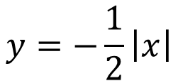
Day 77
$$y=−\frac{1}{2}\left|x\right|$$
Observed Attributes
________________________________________
________________________________________
________________________________________
________________________________________
________________________________________
________________________________________
________________________________________
________________________________________
________________________________________
________________________________________
________________________________________
________________________________________
________________________________________
________________________________________
________________________________________

Slide 82
Day 78
$$y=\left|x−4\right|$$
Observed Attributes
________________________________________
________________________________________
________________________________________
________________________________________
________________________________________
________________________________________
________________________________________
________________________________________
________________________________________
________________________________________
________________________________________
________________________________________
________________________________________
________________________________________
________________________________________

Slide 83
Day 79
$$y=\left|x+5\right|$$
Observed Attributes
________________________________________
________________________________________
________________________________________
________________________________________
________________________________________
________________________________________
________________________________________
________________________________________
________________________________________
________________________________________
________________________________________
________________________________________
________________________________________
________________________________________
________________________________________

Slide 84
Day 80
$$y=\left|x\right|−7$$
Observed Attributes
________________________________________
________________________________________
________________________________________
________________________________________
________________________________________
________________________________________
________________________________________
________________________________________
________________________________________
________________________________________
________________________________________
________________________________________
________________________________________
________________________________________
________________________________________

Slide 85
Day 81
$$y=−\left|x\right|+6$$
Observed Attributes
________________________________________
________________________________________
________________________________________
________________________________________
________________________________________
________________________________________
________________________________________
________________________________________
________________________________________
________________________________________
________________________________________
________________________________________
________________________________________
________________________________________
________________________________________

Slide 86
Day 82
$$y=3\left|x−1\right|−4$$
Observed Attributes
________________________________________
________________________________________
________________________________________
________________________________________
________________________________________
________________________________________
________________________________________
________________________________________
________________________________________
________________________________________
________________________________________
________________________________________
________________________________________
________________________________________
________________________________________

Slide 87
Day 83
$$y=−0.5\left|x+5\right|+8$$
Observed Attributes
________________________________________
________________________________________
________________________________________
________________________________________
________________________________________
________________________________________
________________________________________
________________________________________
________________________________________
________________________________________
________________________________________
________________________________________
________________________________________
________________________________________
________________________________________

Slide 88
Day 84
$$y=2^{x}$$
Observed Attributes
________________________________________
________________________________________
________________________________________
________________________________________
________________________________________
________________________________________
________________________________________
________________________________________
________________________________________
________________________________________
________________________________________
________________________________________
________________________________________
________________________________________
________________________________________

Slide 89
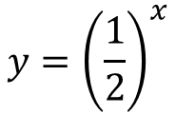
Day 85
$$y={\left(\frac{1}{2}\right)}^{x}$$
Observed Attributes
________________________________________
________________________________________
________________________________________
________________________________________
________________________________________
________________________________________
________________________________________
________________________________________
________________________________________
________________________________________
________________________________________
________________________________________
________________________________________
________________________________________
________________________________________

Slide 90
Day 86
$$y={100(1+0.25)}^{x}$$
Observed Attributes
________________________________________
________________________________________
________________________________________
________________________________________
________________________________________
________________________________________
________________________________________
________________________________________
________________________________________
________________________________________
________________________________________
________________________________________
________________________________________
________________________________________
________________________________________

Slide 91
Day 87
$$y={100(1−0.25)}^{x}$$
Observed Attributes
________________________________________
________________________________________
________________________________________
________________________________________
________________________________________
________________________________________
________________________________________
________________________________________
________________________________________
________________________________________
________________________________________
________________________________________
________________________________________
________________________________________
________________________________________

Slide 92
Day 88
$$y={200(0.6)}^{x}$$
Observed Attributes
________________________________________
________________________________________
________________________________________
________________________________________
________________________________________
________________________________________
________________________________________
________________________________________
________________________________________
________________________________________
________________________________________
________________________________________
________________________________________
________________________________________
________________________________________

Slide 93
Day 89
$$y={200(1.4)}^{x}$$
Observed Attributes
________________________________________
________________________________________
________________________________________
________________________________________
________________________________________
________________________________________
________________________________________
________________________________________
________________________________________
________________________________________
________________________________________
________________________________________
________________________________________
________________________________________
________________________________________

Slide 94
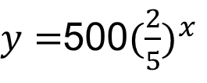
Day 90
$y=$500${(\frac{2}{5})}^{x}$
Observed Attributes
________________________________________
________________________________________
________________________________________
________________________________________
________________________________________
________________________________________
________________________________________
________________________________________
________________________________________
________________________________________
________________________________________
________________________________________
________________________________________
________________________________________
________________________________________

Slide 95
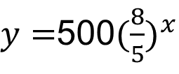
Day 91
$y=$500${(\frac{8}{5})}^{x}$
Observed Attributes
________________________________________
________________________________________
________________________________________
________________________________________
________________________________________
________________________________________
________________________________________
________________________________________
________________________________________
________________________________________
________________________________________
________________________________________
________________________________________
________________________________________
________________________________________

Slide 96
Day 92
$$y={ (−3)}^{x}$$
Observed Attributes
________________________________________
________________________________________
________________________________________
________________________________________
________________________________________
________________________________________
________________________________________
________________________________________
________________________________________
________________________________________
________________________________________
________________________________________
________________________________________
________________________________________
________________________________________

Slide 97
Day 93
$$y=x^{3}$$
Observed Attributes
________________________________________
________________________________________
________________________________________
________________________________________
________________________________________
________________________________________
________________________________________
________________________________________
________________________________________
________________________________________
________________________________________
________________________________________
________________________________________
________________________________________
________________________________________

Slide 98
Day 94
$$y=\sqrt{x}$$
Observed Attributes
________________________________________
________________________________________
________________________________________
________________________________________
________________________________________
________________________________________
________________________________________
________________________________________
________________________________________
________________________________________
________________________________________
________________________________________
________________________________________
________________________________________
________________________________________

Slide 99
Day 95
$$y=\sqrt[3]{x}$$
Observed Attributes
________________________________________
________________________________________
________________________________________
________________________________________
________________________________________
________________________________________
________________________________________
________________________________________
________________________________________
________________________________________
________________________________________
________________________________________
________________________________________
________________________________________
________________________________________

Slide 100
Day 96
$$f\left(x\right)=−\frac{6}{7}x−6$$
$$g\left(x\right)=x^{2}+4x−5$$
Observed Attributes
________________________________________
________________________________________
________________________________________
________________________________________
________________________________________
________________________________________
________________________________________
________________________________________
________________________________________
________________________________________
________________________________________
________________________________________
________________________________________
________________________________________
________________________________________

Slide 101
Day 97
$$f(x)=x−7$$
$$g(x)=−{\left(x−4\right)}^{2}+9$$
Observed Attributes
________________________________________
________________________________________
________________________________________
________________________________________
________________________________________
________________________________________
________________________________________
________________________________________
________________________________________
________________________________________
________________________________________
________________________________________
________________________________________
________________________________________
________________________________________

Slide 102
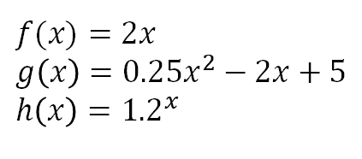
Day 98
$$f(x)=2x$$
$$g\left(x\right)=0.25x^{2}−2x+5$$
$$h\left(x\right)={1.2}^{x}$$
Observed Attributes
________________________________________
________________________________________
________________________________________
________________________________________
________________________________________
________________________________________
________________________________________
________________________________________
________________________________________
________________________________________
________________________________________
________________________________________
________________________________________
________________________________________
________________________________________

Slide 103
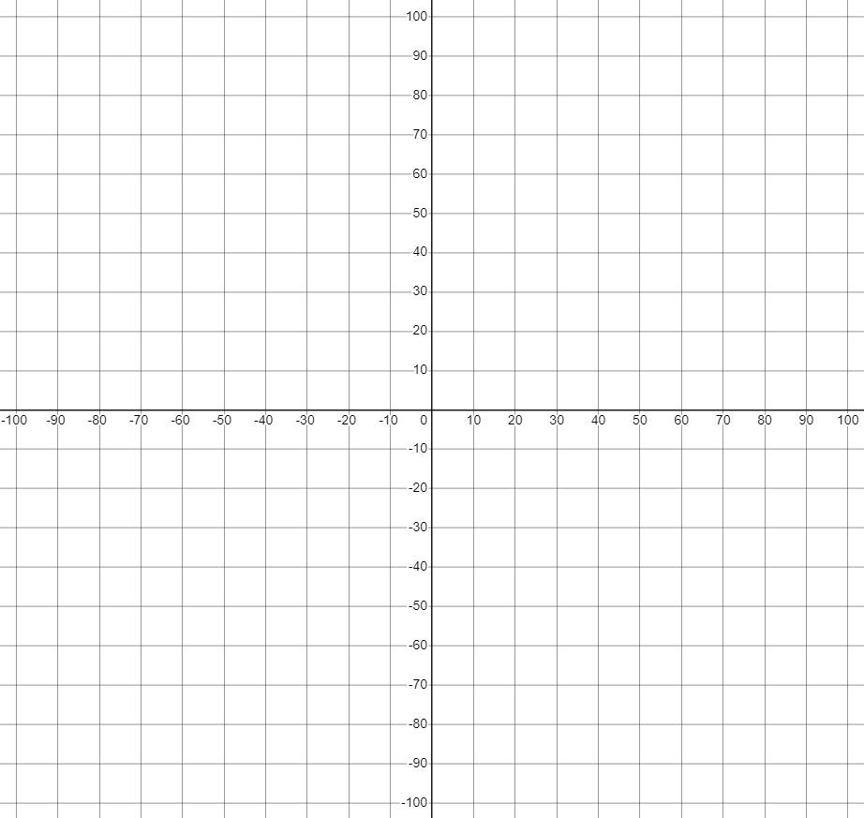
Day 99
$$f(x)=2x$$
$$g\left(x\right)=0.25x^{2}−2x+5$$
$$h\left(x\right)={1.2}^{x}$$
Observed Attributes
________________________________________
________________________________________
________________________________________
________________________________________
________________________________________
________________________________________
________________________________________
________________________________________
________________________________________
________________________________________
________________________________________
________________________________________
________________________________________
________________________________________
________________________________________

Slide 104
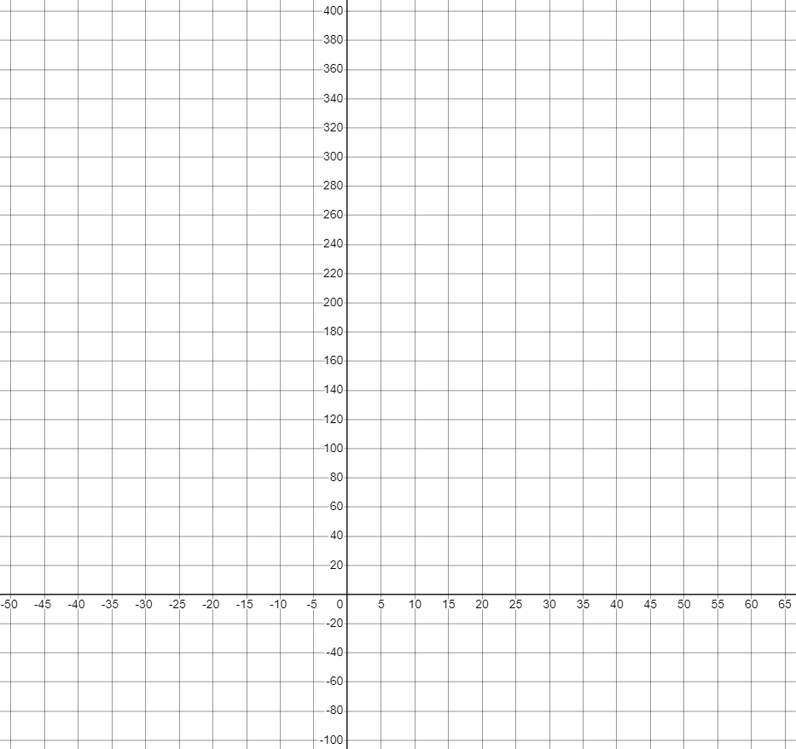
Day 100
$$f(x)=2x$$
$$g\left(x\right)=0.25x^{2}−2x+5$$
$$h\left(x\right)={1.2}^{x}$$
Observed Attributes
________________________________________
________________________________________
________________________________________
________________________________________
________________________________________
________________________________________
________________________________________
________________________________________
________________________________________
________________________________________
________________________________________
________________________________________
________________________________________
________________________________________
________________________________________

Slide 105
Templates

Slide 106
4 Quadrant Coordinate Grid (Numbered)

Slide 107
4 Quadrant Coordinate Grid (Blank)

Slide 108
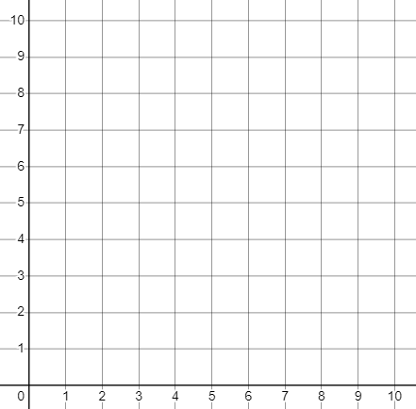
1st Quadrant Coordinate Grid (Numbered)

Slide 109
1st Quadrant Coordinate Grid (Blank)

Slide 110
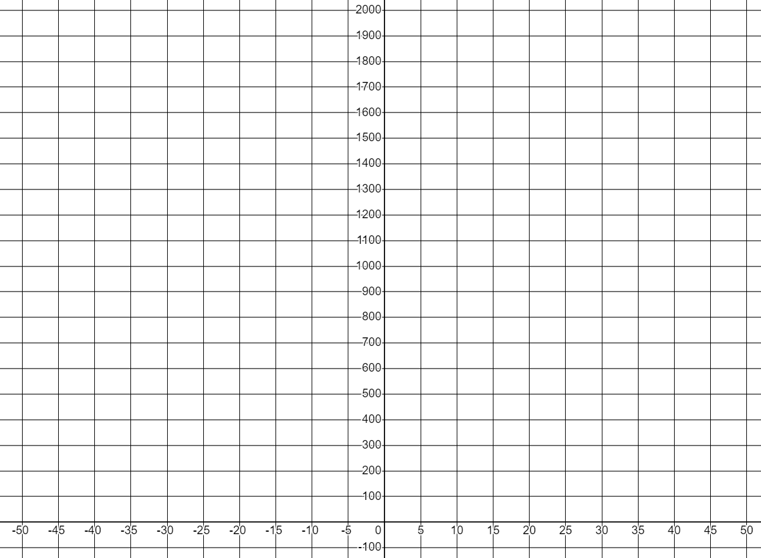
Custom Scaled Grids
Creating a custom scale for a blank coordinate grid is easy with Desmos.
Go to http://desmos.com/calculator and watch this video to learn how.

