Slide 1
MAFS.912.G-SRT.2.5
Use congruence and similarity criteria for triangles to solve problems and to prove relationships in geometric figures.

Slide 2
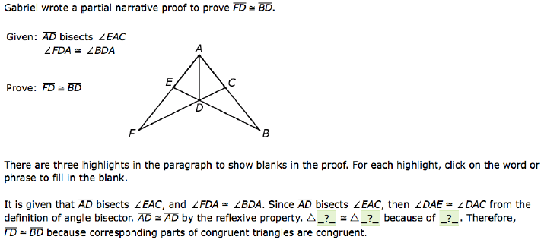
Please choose the appropriate choices from the list below
to complete the following statement: $∆____≅∆_____$ because of the ________ property.
a. : $∆FDA≅∆BDA$because of the SSS property.
b. : $∆EAD≅∆CAD$because of the SSA property.
c. : $∆FDA≅∆BDA$because of the ASA property.
d. : $∆FAD≅∆BAD$because of the AA property.
e. : $∆FAD≅∆BAD$because of the SAS property.

Slide 3
Correct

Slide 4
Incorrect
Click here to try again.

