Slide 1
MAFS.912.G-SRT.2.4
Prove theorems about triangles.

Slide 2
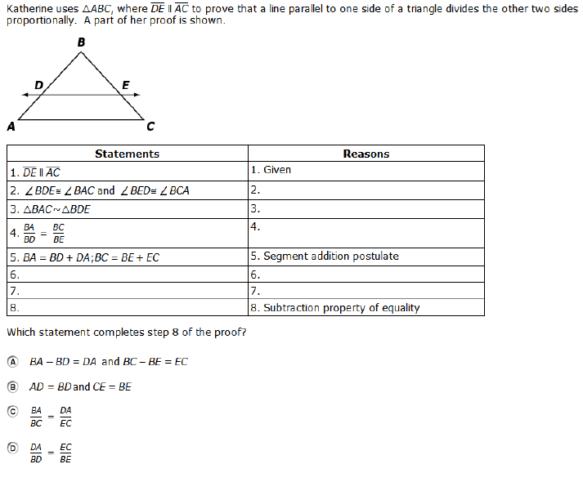

Slide 3
Correct

Slide 4
Incorrect
Click here to try again.

