Slide 1
MAFS.912.G-SRT.1.3
Use the properties of similarity transformations to establish the AA criterion for two triangles to be similar.

Slide 2
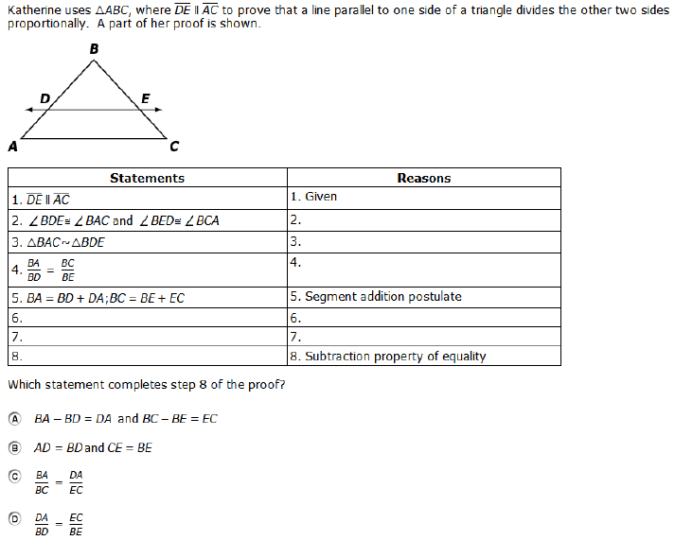

Slide 3
Correct

Slide 4
Incorrect
Click here to try again.

