Slide 1
MAFS.912.G-SRT.1.1
Verify experimentally the properties of dilations given by a center and a scale factor:
a. A dilation takes a line not passing through the center of the dilation to a parallel line and leaves a line passing through the center unchanged.
b. The dilation of a line segment is longer or shorter in the ratio given by the scale factor.

Slide 2
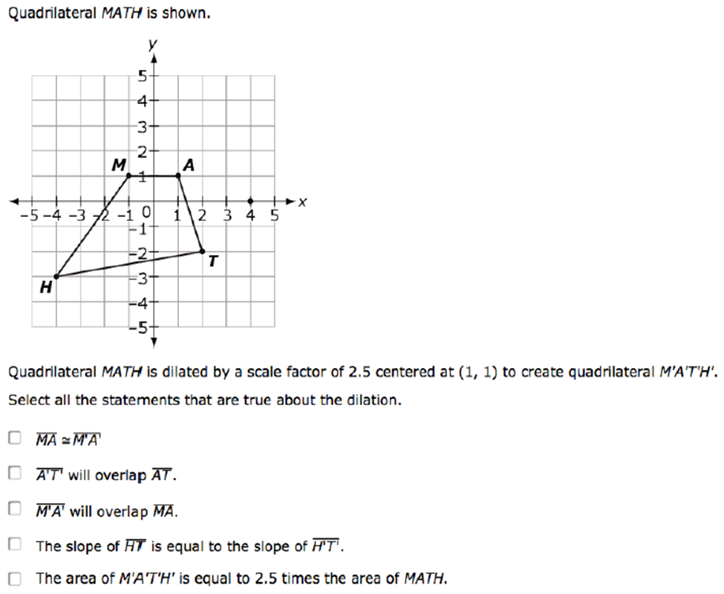

Slide 3
Correct

Slide 4
Incorrect
Click here to try again.

