Slide 1
MAFS.912.S-IC.2.6
Evaluate reports based on data.

Slide 2
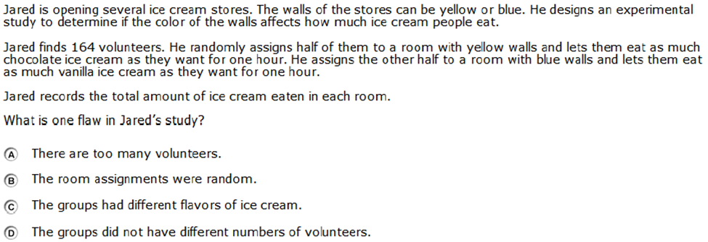

Slide 3
Correct!

Slide 4
Incorrect
Click here to return to question

