Slide 1
MAFS.912.S-IC.2.5
Use data from a randomized experiment to compare two treatments; use simulations to decide if differences between parameters are significant.

Slide 2
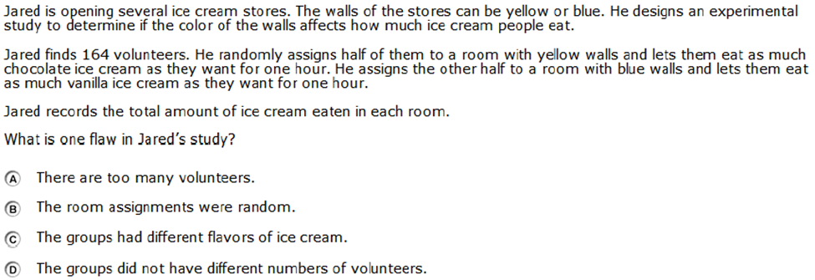

Slide 3
Correct!

Slide 4
Incorrect
Click here to return to question

