Slide 1
MAFS.912.S-IC.2.3
Recognize the purposes of and differences among sample surveys, experiments, and observational studies; explain how randomization relates to each.

Slide 2
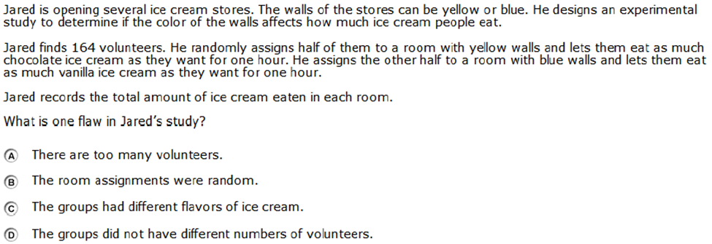

Slide 3
Correct!

Slide 4
Incorrect
Click here to return to question

