Slide 1
MAFS.912.S-IC.1.2
Decide if a specified model is consistent with results from a given data-generating process (e.g., using simulation).

Slide 2
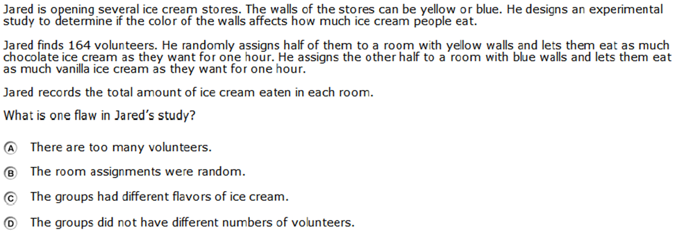

Slide 3
Correct!

Slide 4
Incorrect
Click here to return to question

