Slide 1
MAFS.912.G-GMD.2.4
Identify the shapes of two-dimensional cross-sections of three-dimensional objects, and identify three-dimensional objects generated by rotations of two-dimensional objects.

Slide 2
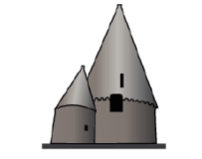
What solids are used to compose the following figure?
[ ] Only cones
[ ] Only cylinders
[ ] Only pyramids
[ ] Cones and cylinders
[ ] Pyramids and cylinders
[ ] Rectangular prisms and cones
[ ] Only rectangular prisms

Slide 3
Correct!
Click here to attempt question 2

Slide 4
Incorrect
Click here to try again.

Slide 5
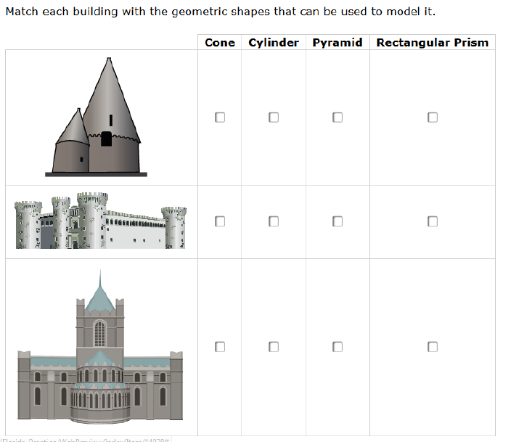
What solids are used to compose the following figure?
[ ] Only cones
[ ] Only cylinders
[ ] Only spheres
[ ] Pyramids and cylinders
[ ] Only rectangular prisms
[ ] Rectangular prism and cylinders
[ ] Rectangular prism and cones

Slide 6
Correct!

Slide 7
Incorrect
Click here to try again.

