Slide 1
MAFS.912.G-GMD.2.4
Identify the shapes of two-dimensional cross-sections of three-dimensional objects, and identify three-dimensional objects generated by rotations of two-dimensional objects.

Slide 2
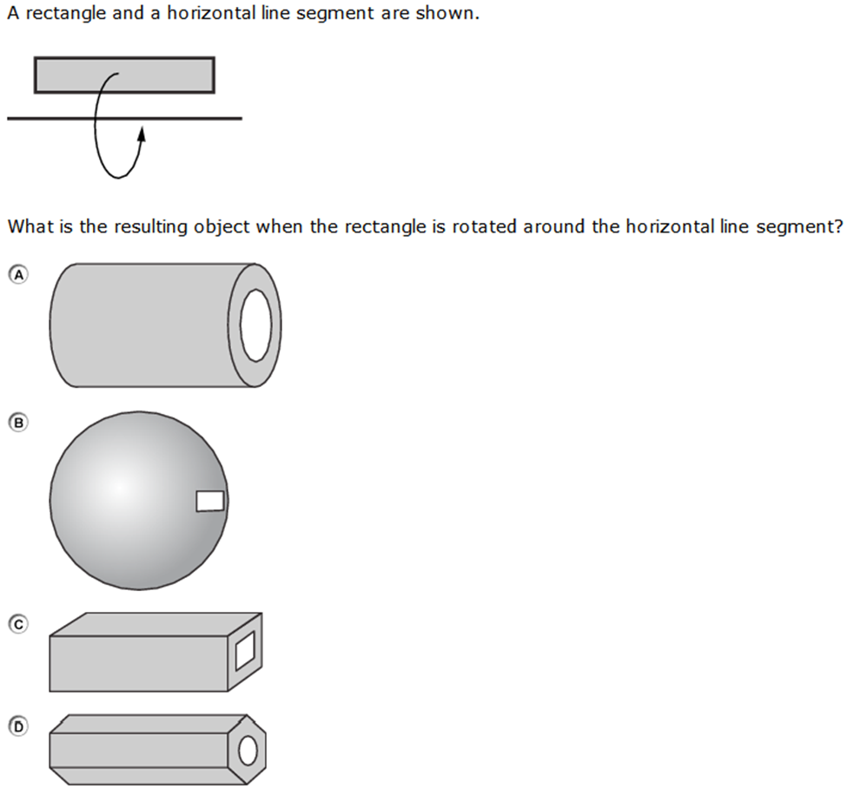

Slide 3
Correct!

Slide 4
Incorrect
Click here to try again.

