Slide 1
MAFS.912.G-CO.3.9
Prove theorems about lines and angles; use theorems about lines and angles to solve problems. Theorems include: vertical angles are congruent; when a transversal crosses parallel lines, alternate interior angles are congruent and corresponding angles are congruent; points on a perpendicular bisector of a line segment are exactly those equidistant from the segment’s endpoints.

Slide 2
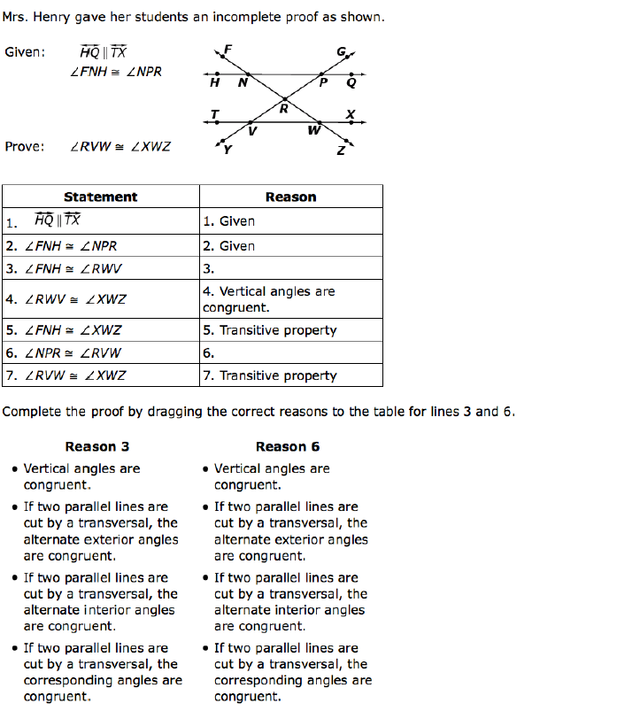
First, select a reason for statement 3:

Slide 3
Now select a reason for statement 6.

Slide 4
Correct!
Click here to choose a reason for statement 6.

Slide 5
Incorrect
Click here to return to question

Slide 6
Correct!
Great job!
Click here to see correct answers.

Slide 7
Incorrect
Click here to return to question

