Slide 1
MAFS.912.G-CO.2.8
Explain how the criteria for triangle congruence (ASA, SAS, SSS, and Hypotenuse-Leg) follow from the definition of congruence in terms of rigid motions.

Slide 2
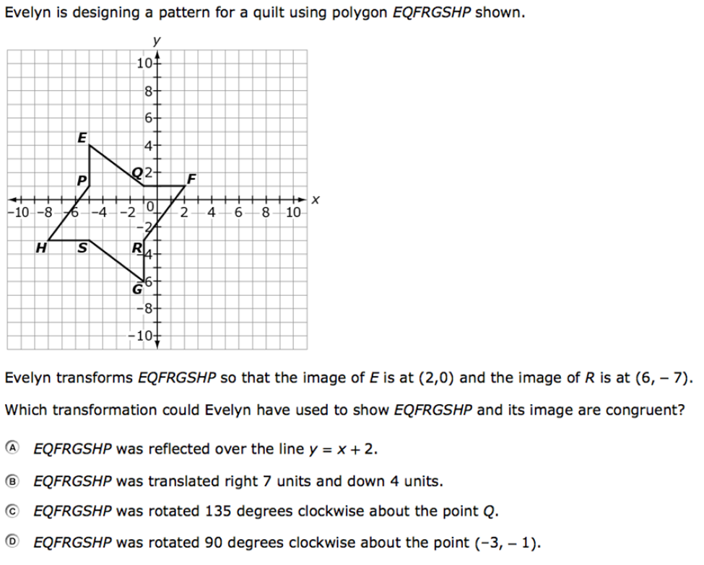

Slide 3
Correct!
Click here to return to the question.

Slide 4
Incorrect
Click here to try again.

