Slide 1
MAFS.912.G-CO.2.6
Use geometric descriptions of rigid motions to transform figures and to predict the effect of a given rigid motion on a given figure; given two figures, use the definition of congruence in terms of rigid motions to decide if they are congruent.

Slide 2
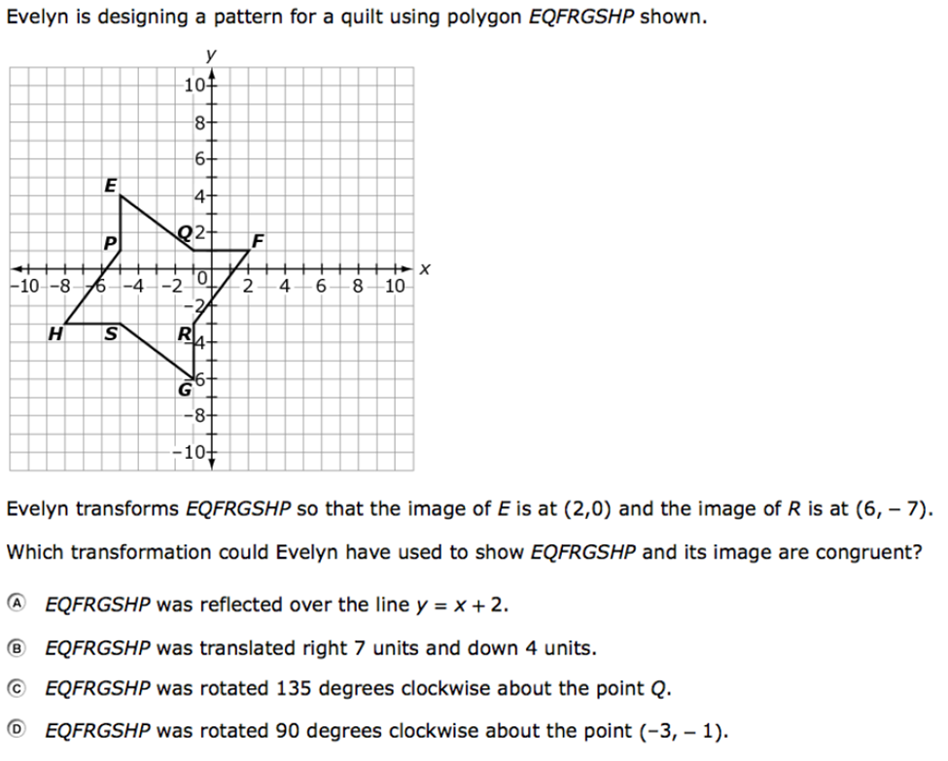

Slide 3
Correct!
Click here to return to the question.

Slide 4
Incorrect
Click here to try again.

