Slide 1
MAFS.912.G-CO.1.3
Given a rectangle, parallelogram, trapezoid, or regular polygon, describe the rotations and reflections that carry it onto itself.

Slide 2
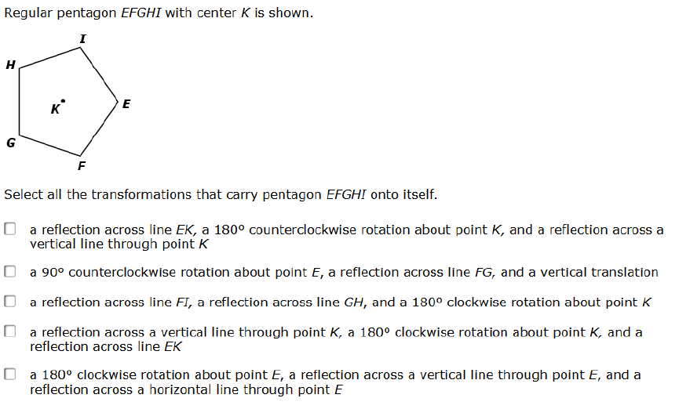

Slide 3
Great job! Now click here to return to original question and to try the other options.

Slide 4
Incorrect. Click here to return to original question and to try the other options.

Slide 5
Incorrect. Click here to return to original question and to try the other options.

Slide 6
Incorrect. Click here to return to original question and to try the other options.

Slide 7
Great job! Now click here to return to original question and to try the other options.

