Slide 1
MAFS.912.A-SSE.1.2
Use the structure of an expression to identify ways to rewrite it. For example, see x4– y4 as (x²)² – (y²)², thus recognizing it as a difference of squares that can be factored as (x² – y²)(x² + y²).

Slide 2
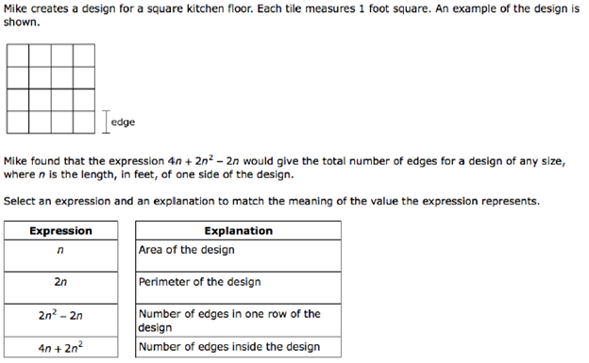

Slide 3
Return to first slide

Slide 4
Return to first slide

Slide 5
Now choose the explanation that fits.

Slide 6
Return to previous slide

Slide 7
Return to previous slide

Slide 8
Return to previous slide

Slide 9
Return to previous slide

Slide 10
Correct!

