Slide 1
MAFS.912.A-SSE.1.1
Interpret expressions that represent a quantity in terms of its context.
a. Interpret parts of an expression, such as terms, factors, and coefficients.
b. Interpret complicated expressions by viewing one or more of their parts as a single entity. For example, interpret P(1+r)n as the product of P and a factor not depending on P.

Slide 2
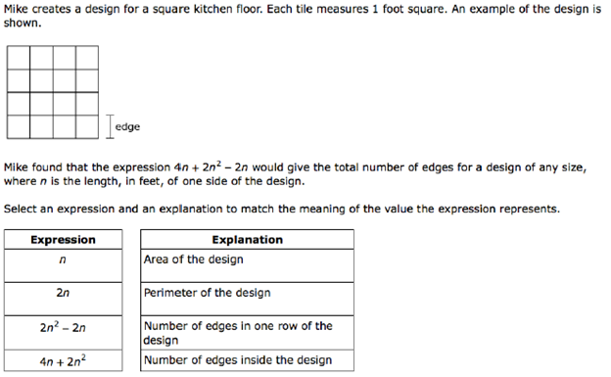

Slide 3
Return to first slide

Slide 4
Return to first slide

Slide 5
Now choose the explanation that fits.

Slide 6
Return to previous slide

Slide 7
Return to previous slide

Slide 8
Return to previous slide

Slide 9
Return to previous slide

Slide 10
Correct!

