Slide 1

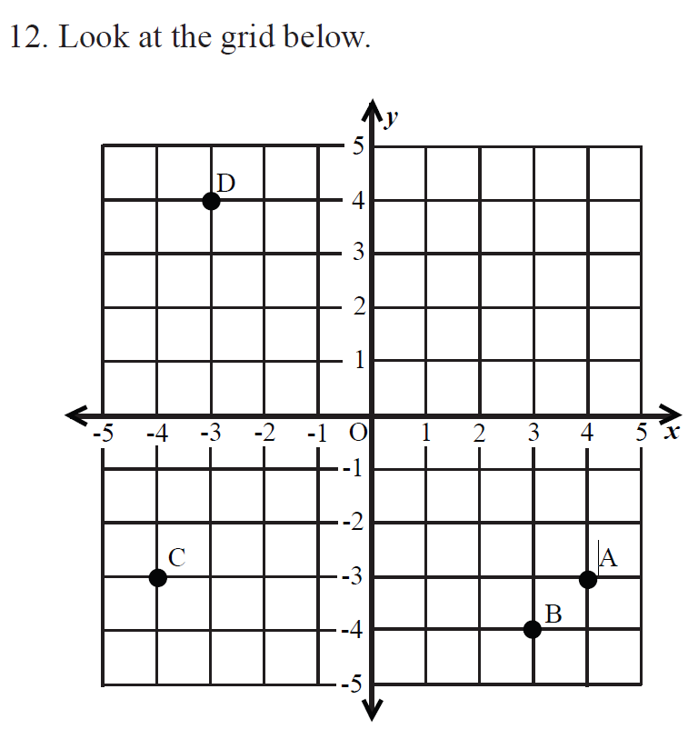
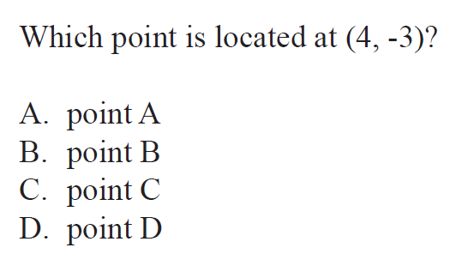

6.NS.3.6 Number Lines and Coordinate Axes

Slide 2
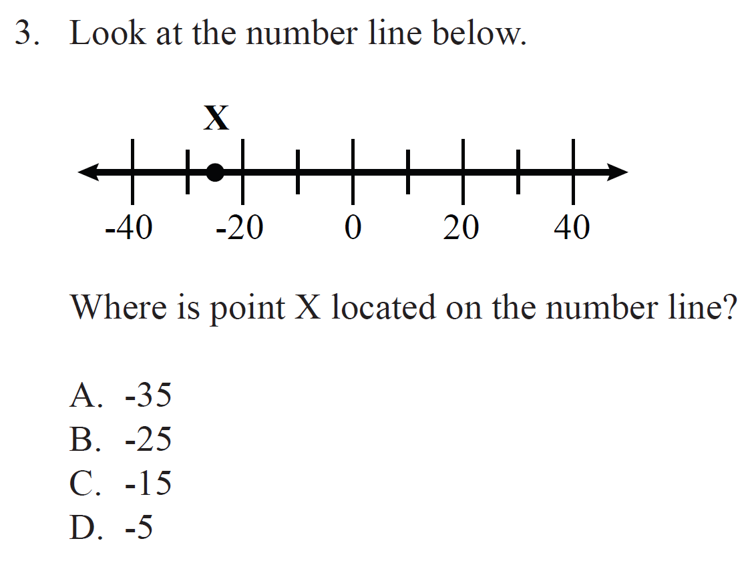
6.NS.3.6 Number Lines and Coordinate Axes

